Slide 1
Clicker Game
Austin Krieger & quinton halliday

Slide 2
What does your program do?
Our program is an idle game made in Unity.
There are 3 bumpers on the screen that a bouncing ball must hit for you to earn cash, buttons on the bottom allow you to add more balls, upgrade the collection rate, and we even included an option to automate some upgrading.
There is no specified goals or win conditions, however there are five achievements that you can earn and the maximum amount of cash you can collect is roughly $18,446,744,073,709,551,615 (Unsigned 64-bit integer)

Slide 3
How does your project connect to object-oriented design?
All but one of our scripts inherit from MonoBehaviour, because when your scripting for Unity you need the functions in MonoBehaviour to do things like change the text in game, manipulate physics, instantiate objects, and lots of other features.
Other than that we have some private static fields and methods as well as some properties for the private fields.

Slide 4
Answering jason’s concerns
Multiple Start and Update methods?
Straight from the Unity documentation:
MonoBeheviour.Start() is called on the frame when a script is enabled just before any of the update methods are called for the first time.
MonoBehaviour.Update() is called every frame, if the MonoBehaviour is enabled. This is the most commonly used function to implement any kind of game behaviour.

Slide 5
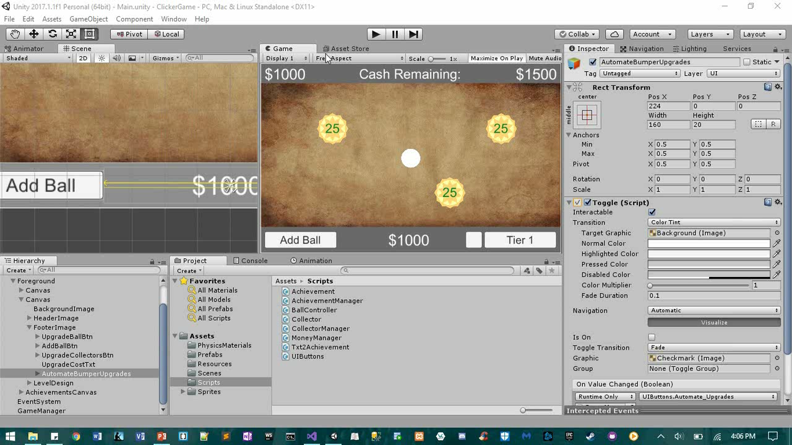
Demo (sped up)

Slide 6
What worked? What did not?
We were using a signed int32 for the cash values on the top but with our upgrades it would integer overflow and go from 2,147,483,647 to -2,147,483,647 somewhat quickly. So we made it a “feature” not a bug by making an achievement for it and then decided people should be able to make even more money and converted the variables to unsigned int64s, but left in the achievement for getting to the int32 overflow amount.

Slide 7

Questions?

